Slide 1

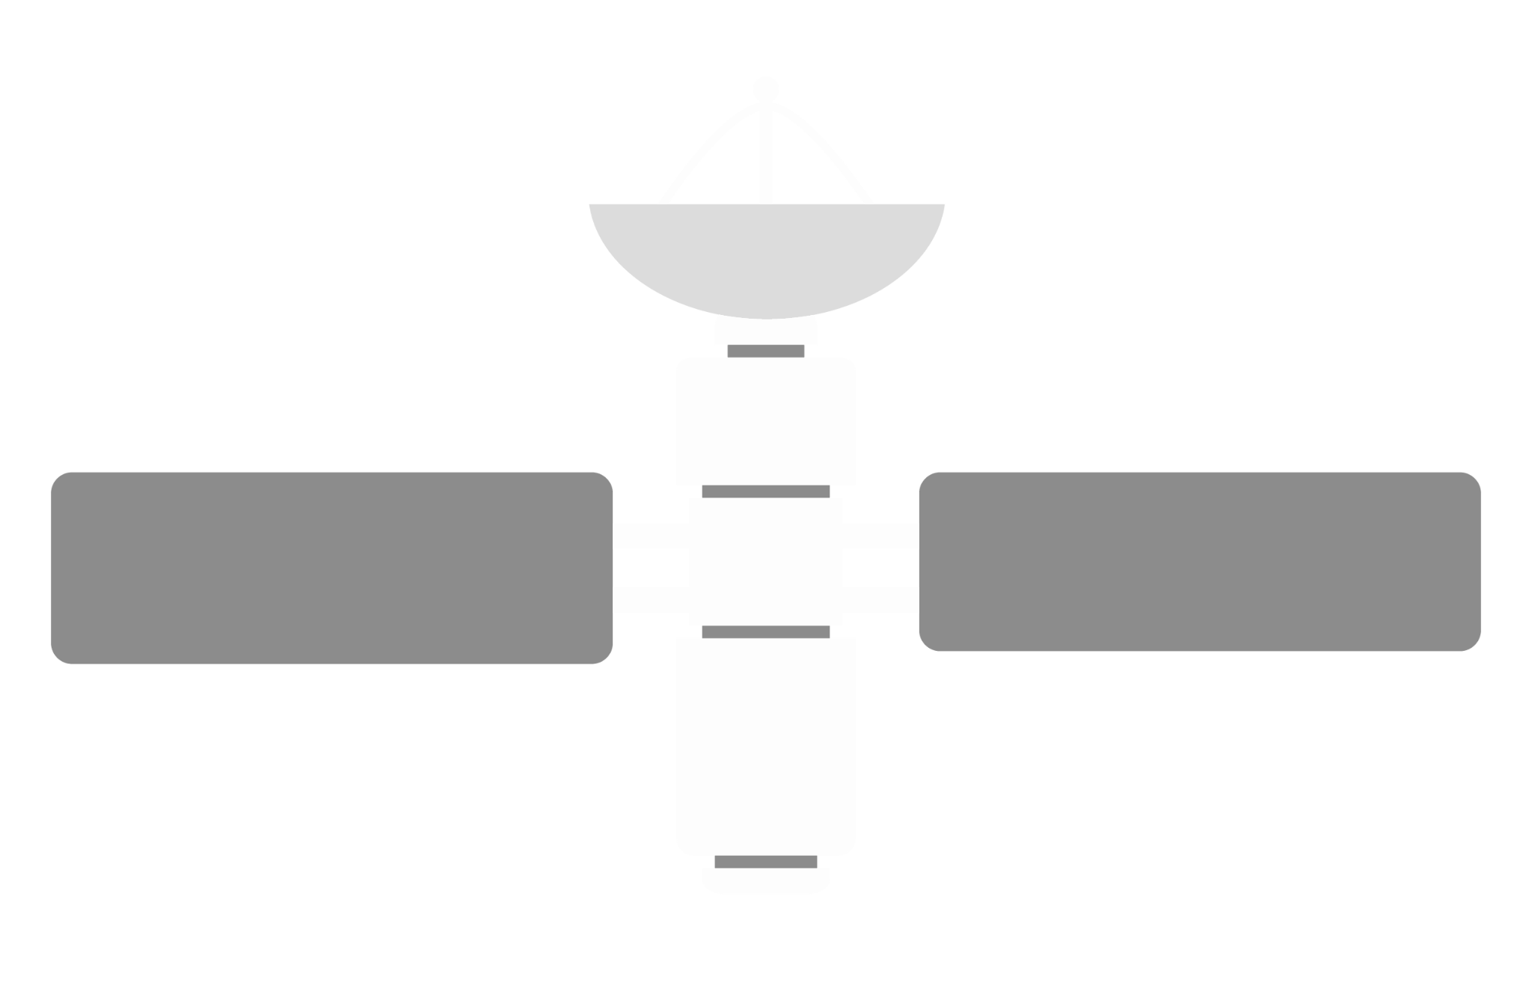
Satellite Antenna
Tracking System
ECEN | 403-902
Sponsor - David Gent
TA - Pranav Dhulipala
Team - David Santos, Michael Raabe, Hunter Britton
Photo from Pexels.com by @InstaWalli

Slide 2
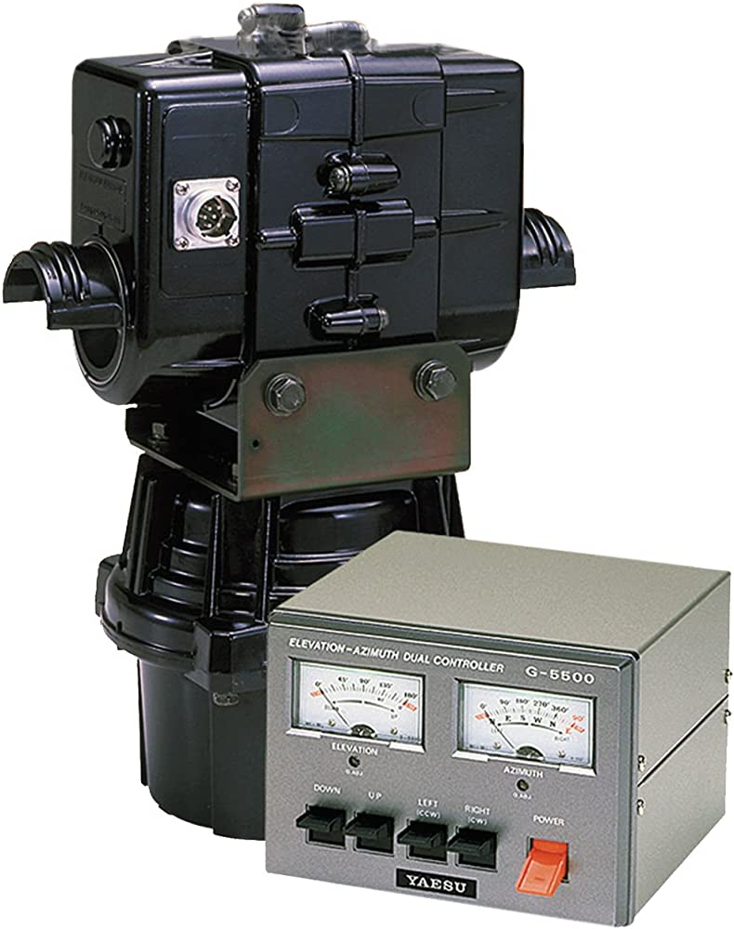
Project Summary
Problem Statement
Amatuer radio enthusiasts rely on outdated, proprietary software and expensive hardware
Remote operation infeasible
Our Solution
Affordable Hardware + Web UI
Flexible, Collaborative, and Inexpensive
Yaesu G-5500 Rotator
Source: Amazon.com

Slide 3

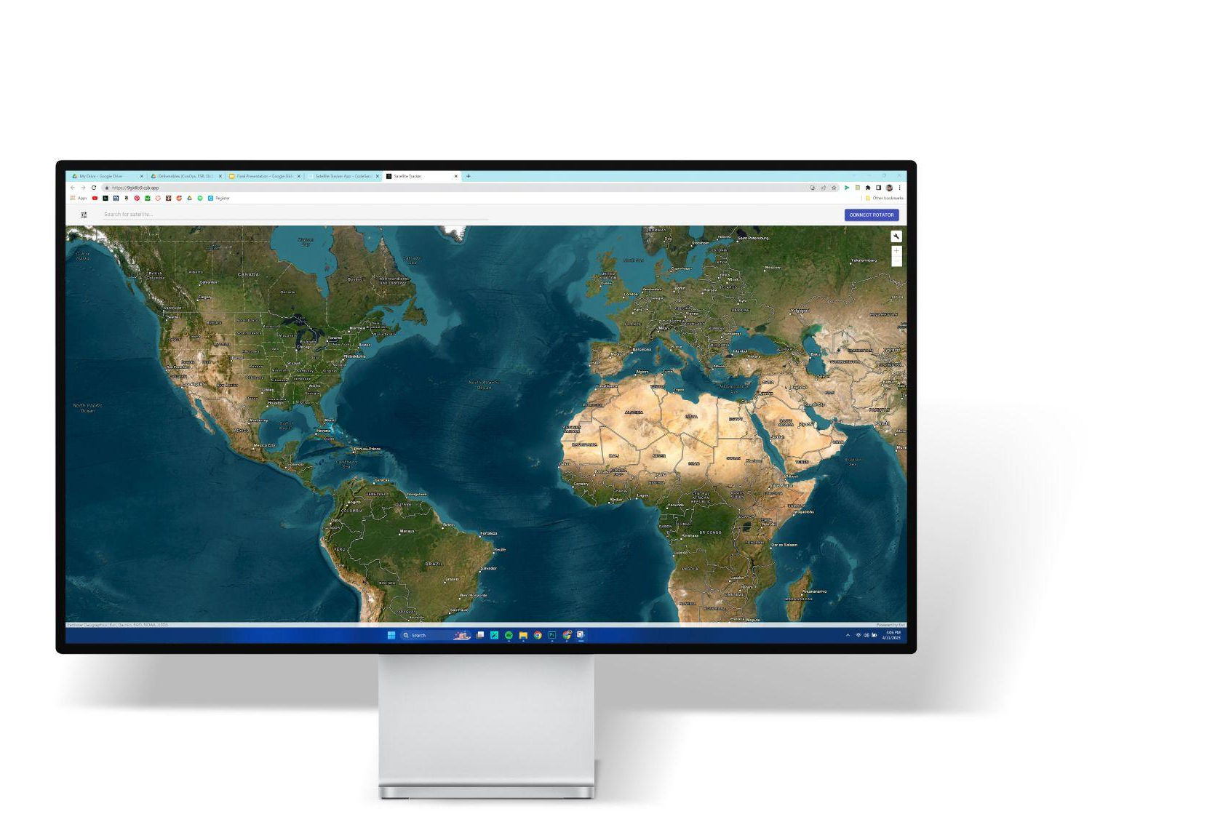
Solution
Satellite
Web Browser
Yagi Antenna
Rotator
Microcontroller

Slide 4
System Block Diagram
SDR
Web App
UI Components
Firebase
MCU Port
Antenna Array
Rotator
Custom PCB
Microcontroller/IO
Elevation Motor
Motor Driver
Display
Wifi
Azimuth
Motor
PSU
MCU
GPS
Legacy
Michael Raabe
Hunter Britton
David Santos

Slide 5
MCU/IO - Hunter Britton
MCU/IO
Display
MCU
Completed
GPS Configuration/Testing
SGP4 Geodetic Coordinate Calculations
Display Output
Position
Sensor IO
Status
Motor Control
SGP4
WIFI
ESP8266
GPS

Slide 6
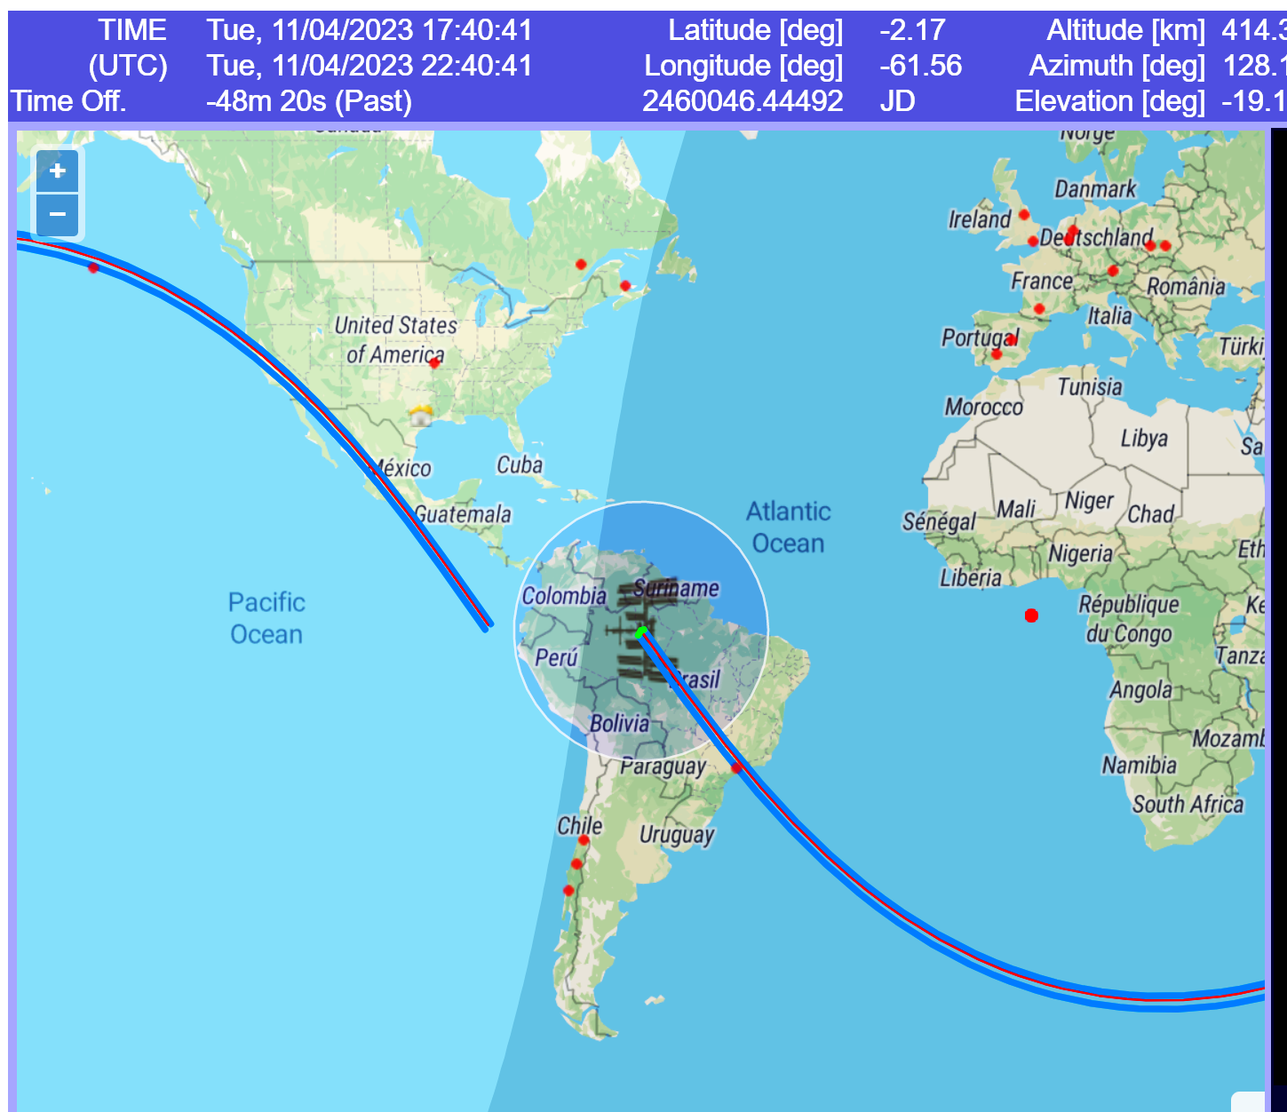
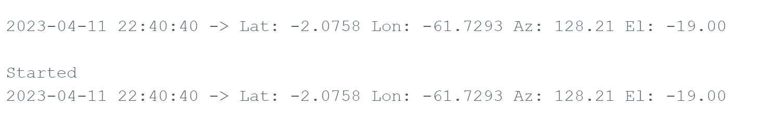
TLE Propagation - Hunter Britton
2023-04-11 22:40:40 ->
Latitude: -2.0758
Longitude: -61.7293
Azimuth: 128.21
Elevation: -19.00
Arduino Approximation
Actual Coordinates of ISS

Slide 7
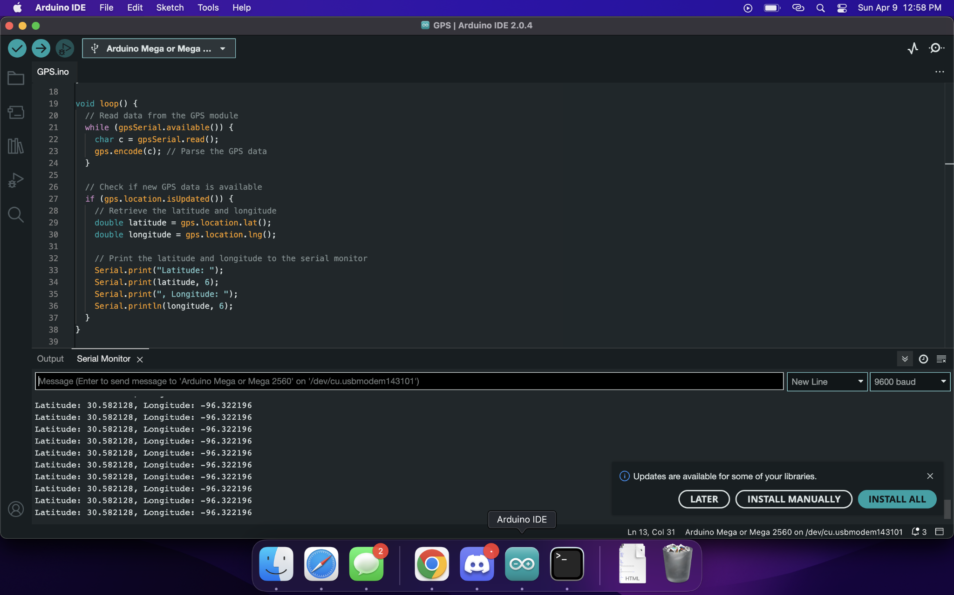
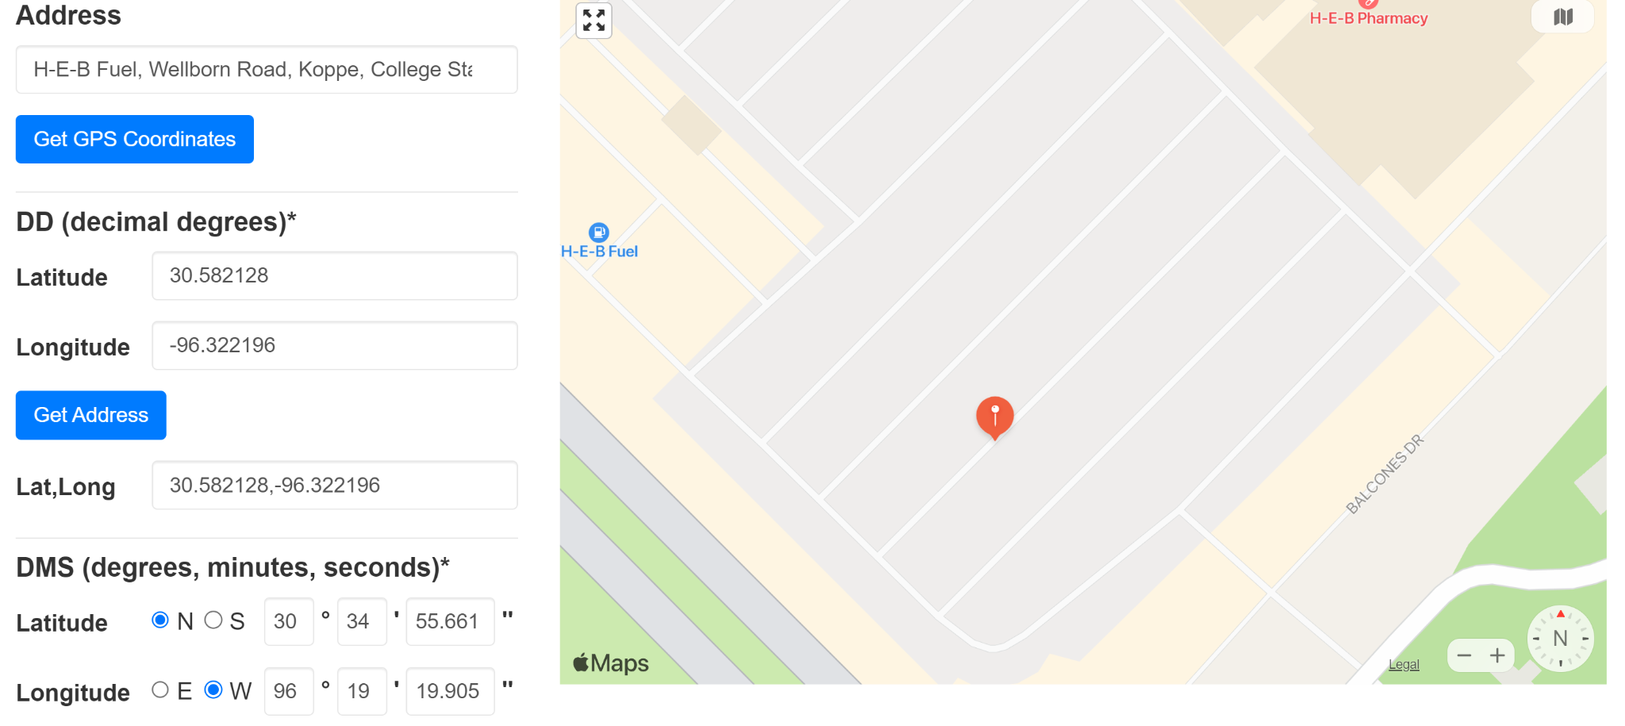
GPS Location - Hunter Britton
GPS location
Location on Map

Slide 8
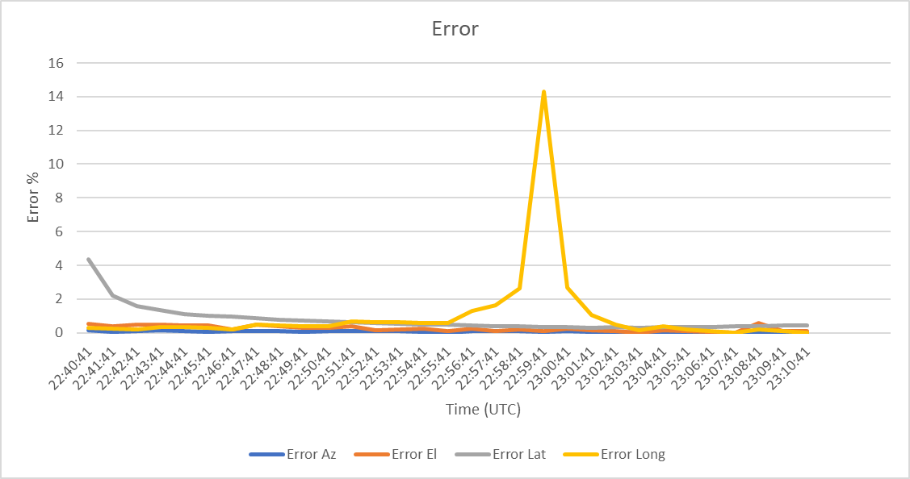
Approximation % Error - Hunter Britton
Average Azimuth Error (%) | 0.07293906
Average Elevation Error (%) | 0.247401878
Average Latitude Error (%) | 0.762077124
Average Longitude Error (%) | 1.033784615

Slide 9
PSU/ Motor - Michael Raabe
Custom PCB
Motor Driver
Tasks
Schematics/Simulations (Done)
Perfboard Prototype (In Progress)
PCB Layout (In Progress)
2A
PSU
Motor Driver
(24 V/2A) (6V/70mA)
110 VAC
Input
MCU
(9 VDC/200 mA)

Slide 10
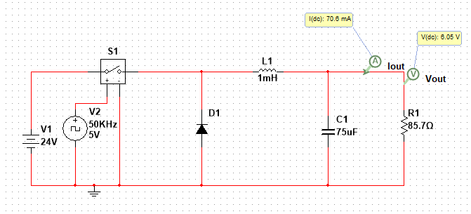
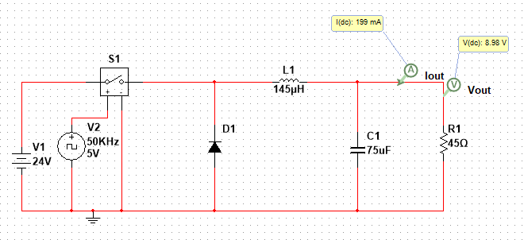
Buck Converter Circuits
24V to 6V Buck Converter
24V to 9V Buck Converter

Slide 11
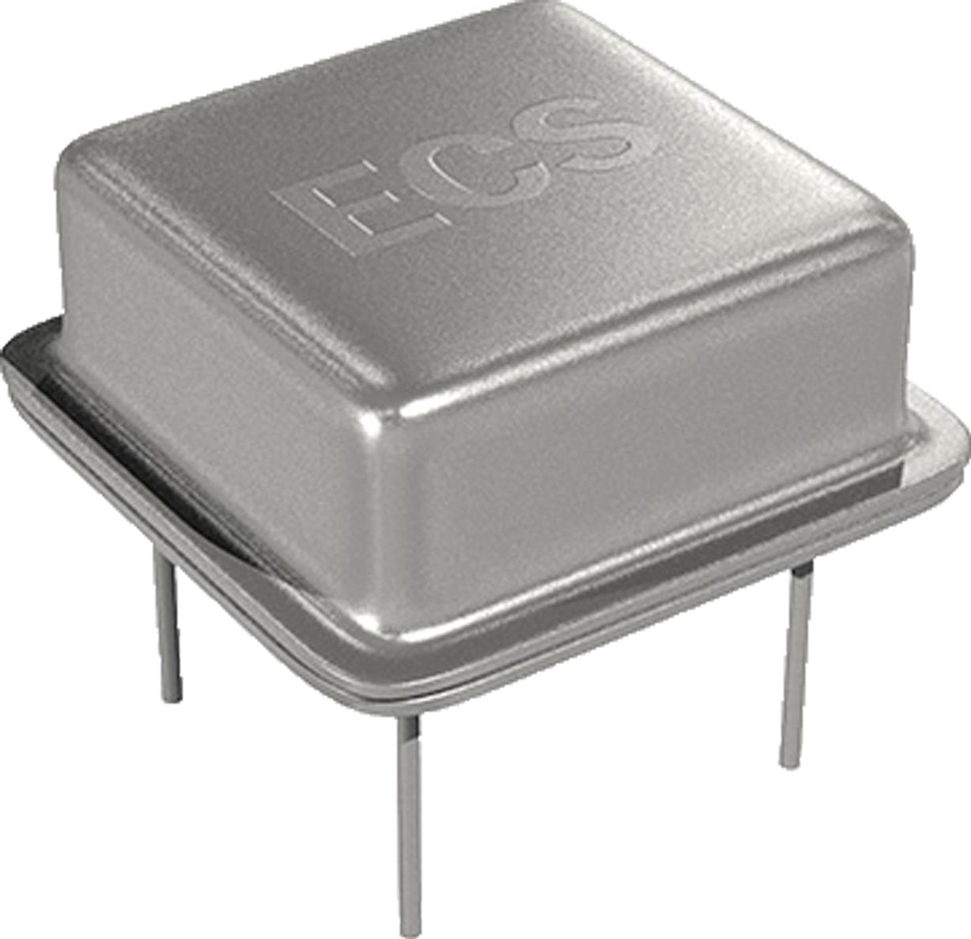
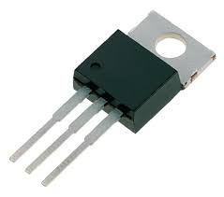
Driver Circuit
Crystal Oscillator + MOSFET -> 5V, 50 KHz square wave to drive buck converter circuits
https://www.arrow.com/en/products/ecs-2100ax-500/ecs-international
https://www.amazon.com/IRF530N-IRF530-Power-N-Channel-transistor/dp/B00I6IAF4O

Slide 12
Web UI - David Santos
Web App
UI
Backend
Completed
Satellite Selection/Orbital Data Retrieval
MCU Http/Json Request
React Components (1342 lines)
ArcGis Interactive Map
Satellite Selection
Firebase
Operation Control
ArcGis API
Visualization
Animated
projection
MCU Port
Sensor Out

Slide 13
React Components
App.js
Mercator Map
Toolbar
Search Bar
Map Settings
Satellite Text Input
ArcGis Instance
Show Grid
Suggestions List
Show Day/Night
Basemap
Show Ground Track
Dropdown Menu
Ground Track
Satellite Info
Dynamic Grid
Rotator Connect
Autotrack
Rotator Info
Terminator
Azimuth Input
IP Input
Elevation Input
Cancel Btn
Start Btn
Connect Btn
Snack Bar

Slide 14
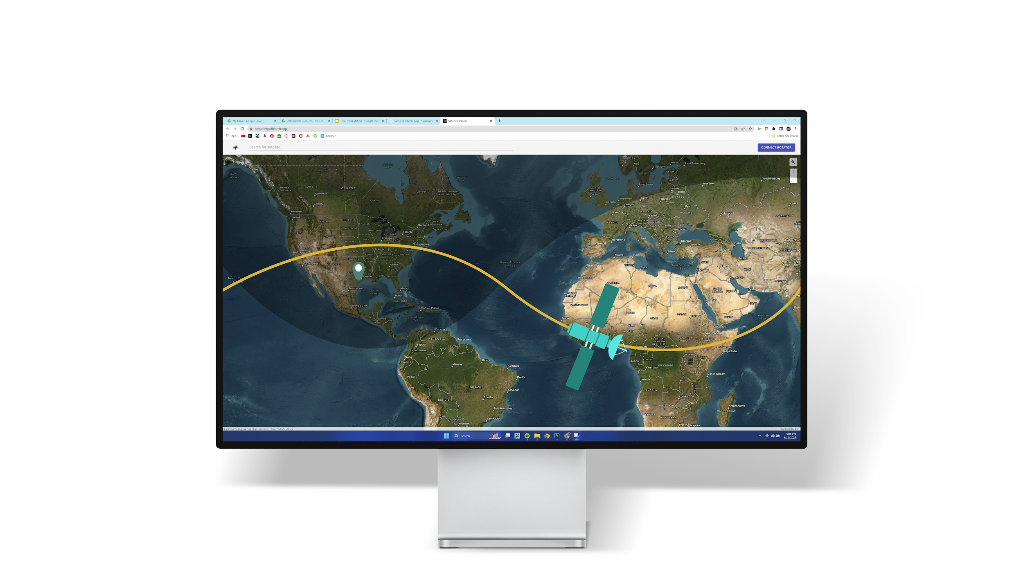
User Interface - David S.

Slide 15
User Interface - David S.

Slide 16
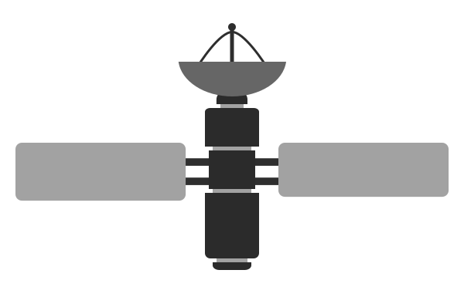

Iconography - David Santos
Satellite
CubeSat

Slide 17
Execution Plan
Completed
In Progress
Task
Owner
FEB
MARCH
APRIL
Feb 27
March 6
March 13
March 20
March 27
April 3
April 10
April 17
April 24
React Components
David S.
Toolbar
Orbital Data Fetching
Mercator Map
Validation
Interactive Map
David S.
ArcGis Instance
Map Settings
Graphics
Validation
Firebase Hosting
David S.
Add to Project
MCU/Rotator Communication
David S.
Hunter B.
Order ESP8266
HTTPS Server
Rotator Controls
Validation
TLE Propagation
Hunter B.
Research Orbital Dynamics
Arduino Implementation
Calc/Improve Accuracy
MCU IO (GPS/LED)
Hunter B.
GPS Code
LED Display
Validation
Power Supply Unit
Michael R.
Define Specifications
Order Parts
Simulations/Assembly
PCB Layout
Motor Drivers
Michael R.
Define Specifications
Order Parts
Test Parts

Slide 18
Validation Summary
Web Application - David Santos
PSU/ Motor Drivers - Michael Raabe
MCU/IO - Hunter Britton
Test Group
Progress
Test Group
Progress
Test Group
Progress
Function Unit Tests
30/30
Motor Driver Pwr
3/5
GPS Location
2/3
UI Behavior Tests
17/17
PSU Delivery
0/10
LED Display
3/3
ESP8266 Latency
1/1
24v-9v Converter
0/6
Coordinates
8/10
Edge Cases
6/6
24v-6v Converter
0/6
Cross-Browser
3/3
Code Review
10/27
Usability Feedback
2/5

Slide 19

ECEN 404 Agenda
Tasks
MCU Motor Control
Rotator/Motor Driver Integration
Real-Time Position Feedback
Field Validation Testing
UI Aesthetic Styling

